Slide 1
STA 9750
Software Tools for Data Analysis
Final Project
Marc Packles
Mariya Mithaiwala
Areum Jung

Slide 2

Contents
Introduction of the data
Data Exploration
Methods
Results
Summary

Slide 3
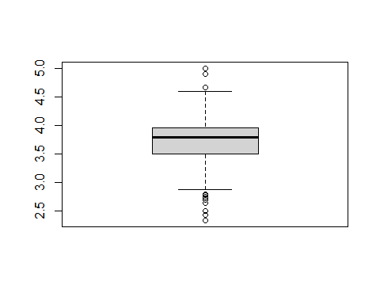
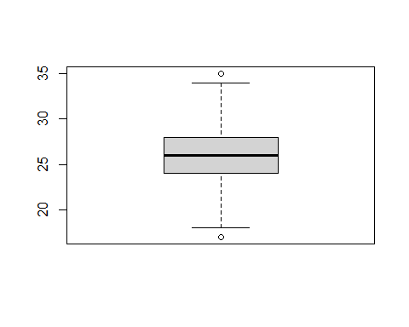
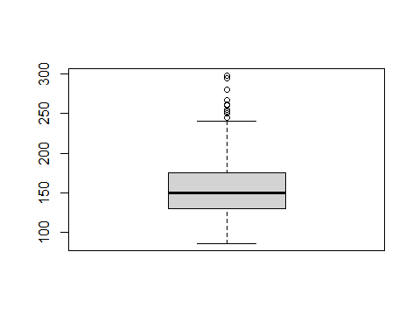
Box Plot analysis and visualization
# Boxplots: we can get boxplots for continuous variables to see if their data is skewed or normally distributed. # Also if they have any outliers. boxplot(edu$HSGPA) # some outliers are shown.
boxplot(edu$ACT) # two outliers are shown, the data looks normally distrbiuted though.
boxplot(edu$Weight) # there are outliers.

Slide 4
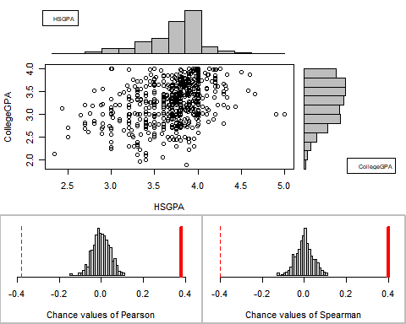
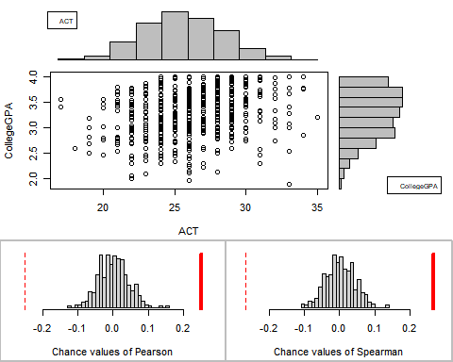
Assocation Analysis
## Permutation procedure: ## Value Estimated p-value ## Pearson's r 0.2503677 0 ## Spearman's rank correlation 0.2674683 0 ## With 500 permutations, we are 95% confident that: ## the p-value of Pearson's correlation (r) is between 0 and 0.007 ## the p-value of Spearman's rank correlation is between 0 and 0.007 ## Note: If 0.05 is in this range, increase the permutations= argument.
## Permutation procedure: ## Value Estimated p-value ## Pearson's r 0.3760406 0 ## Spearman's rank correlation 0.3975337 0 ## With 500 permutations, we are 95% confident that: ## the p-value of Pearson's correlation (r) is between 0 and 0.007 ## the p-value of Spearman's rank correlation is between 0 and 0.007

Slide 5
Contents

Slide 6
Contents
Introduction of the data
Data Exploration
Methods
Results
Summary

